Slide 1
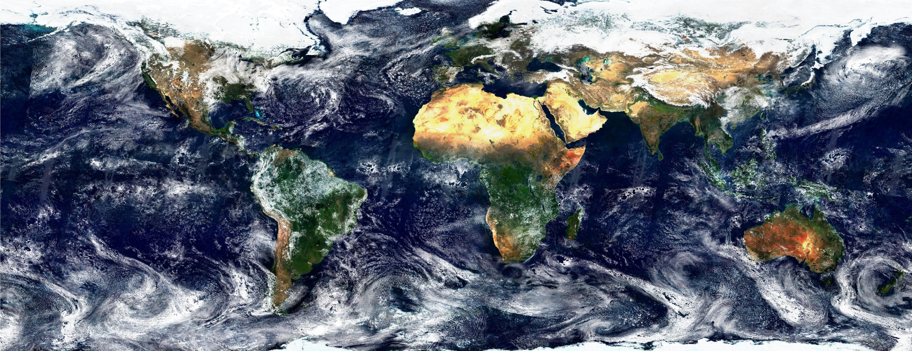

Feasibility Analysis of Landsat - MODIS Data Fusion Datenfusion von moderat- und hochaufgelösten optischen Fernerkundungsdaten zur Erlangung eines zeitlich und räumlich hochauflösenden synthetischen Produkts
Ka Hei Chow

Slide 2
Content
Objective
Background: Data Fusion
Existing Algorithms and Implementations
Literature Review: Algorithm Comparison Summary
Workflow
Preliminary Results
Performance Evaluation
Conclusion

Slide 3
Objective
Improvement of Global Water Pack Resolution using fused Landsat and MODIS imagery
Evaluate performance of algorithms with specific use case (Red and NIR bands)
Runtime
Accuracy
Test Implementation in Python and R

Slide 4
Background: Data Fusion
Combine information from two temporally overlapping time series to create a single time series with High temporal resolution and spatial resolution
Fusion is computed based on spatial correlation of input imageries with Pair-dates
Multiple approaches exist yet limited implementations (Both R & Python)
ImageFusion: R interface for the imagefusion framework, which provides implementation of the FITFC, ESTARFM and STARFM algorithms in C++
Starfm4py: STARFM fusion model for Python

Slide 5
Literature Review
Data Fusion initially developed at NASA (STARFM) which have been the most widely tested and used
Multiple approaches have been developed after STARFM, including ESTARFM and FIT-FC
Most proposed methods claim superior performance to STARFM
Evaluated performance highly based on multiple factors
(e.g. spatial heterogeneity and temporal dynamics)

Slide 6
Performance Dependency
Accuracy
Fusion algorithm
Spatial Heterogeneity
Quantity of image references
Dynamics of spatial changes
Accuracy of cloud masking
Time
Pre-processing algorithm
Fusion algorithm
Number of Image Pairs
(Quantity of pre-processing files)

Slide 7
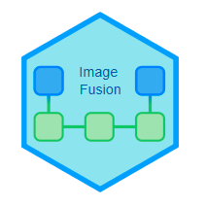
Algorithms and Implementations
* https://github.com/JohMast/ImageFusion
Approach | STARFM | FITFC | ESTARFM
Description | Evaluating spectral similarity of neighbouring pixels | regression fitting, spatial filtering and residual compensation | Enhanced STARFM based on the spectral unmixing theory to improve sub-pixel prediction
Accuracy | 92.6% | 82.6% | 96.6%
Pre-processing Time | 52min | 52min 41s | 1h 12min
Data Fusion Runtime | 35min w/o cloud masking & interpolation | 34min w/o cloud masking & interpolation | 24 min w/o cloud masking & interpolation
File Size | ~83.7 MB + 16 GB | ~74 MB + 11 GB | ~72 MB + 16 GB

Slide 8
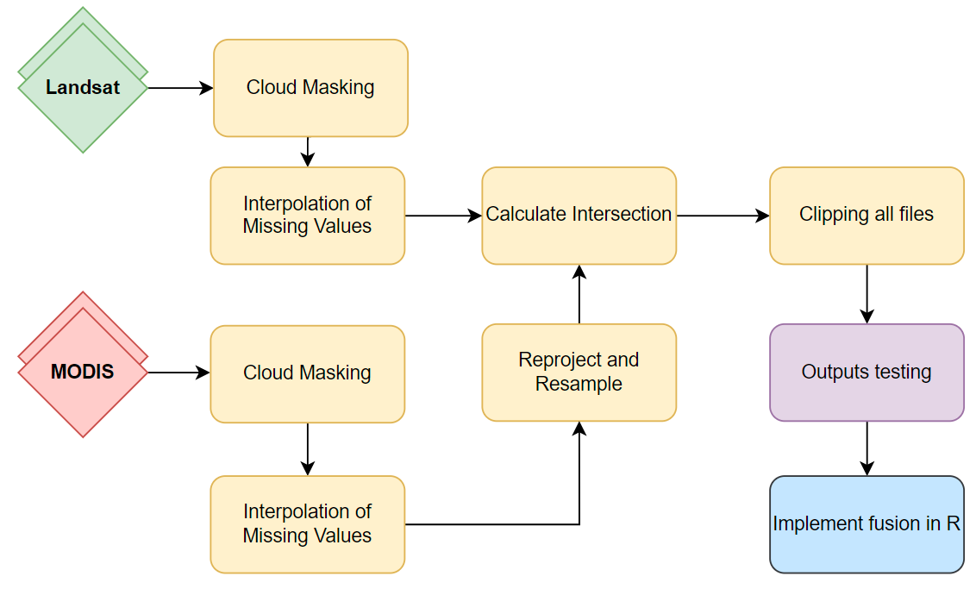



Workflow
Pre-processing
Cloud Masking
Reprojection of MODIS and Landsat
Extent clipping
Resampling for identical resolution
Outputs inspection
Implement fusion

Slide 9
Run pre-processing followed by data fusion
integrate_fusion()
Checking if output files have desired format after pre-processing
fusion_preprocess()
check_files()
Run gdal command line in Python API using subprocess
call_fitfc()
run()
Wrap R functions in
ImageFusion in Python with computed input arguments
call_starfm()
Get intersection for clipping
get_intersect()
call_estarfm()
get_date()
Get date to write metadata to pre-processed outputs
get_epsg()
Get EPSG code for
reprojection

Slide 10
Preliminary Results
STARFM, FITFC, ESTARFM are implemented in the R package
Processing time for one MODIS subset (Landsat coverage) is approximately 25+ min (pre-processing) and 30 min (data fusion) for a single band
All algorithms provide reasonable results with shifted data range
Data fusion, regardless of algorithms, significantly increase processing time for further application owing to warping time for every subset of MODIS imagery
Data fusion will increase further processing steps, such as, merging fused MODIS subsets into full MODIS coverage

Slide 11
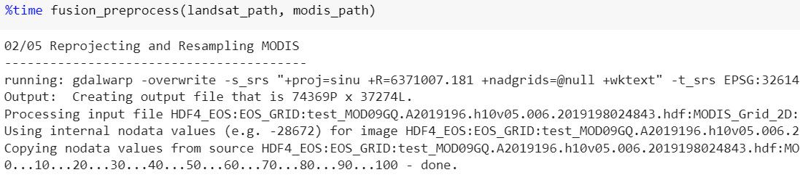
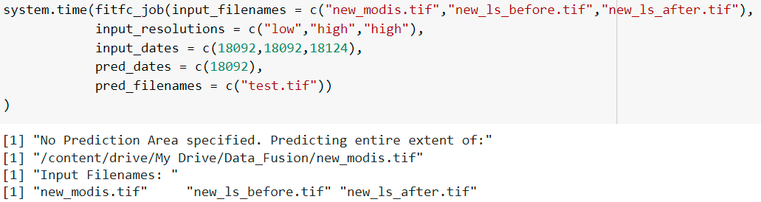
Preliminary Results
Running Functions using subprocess
Data Fusion

Slide 12
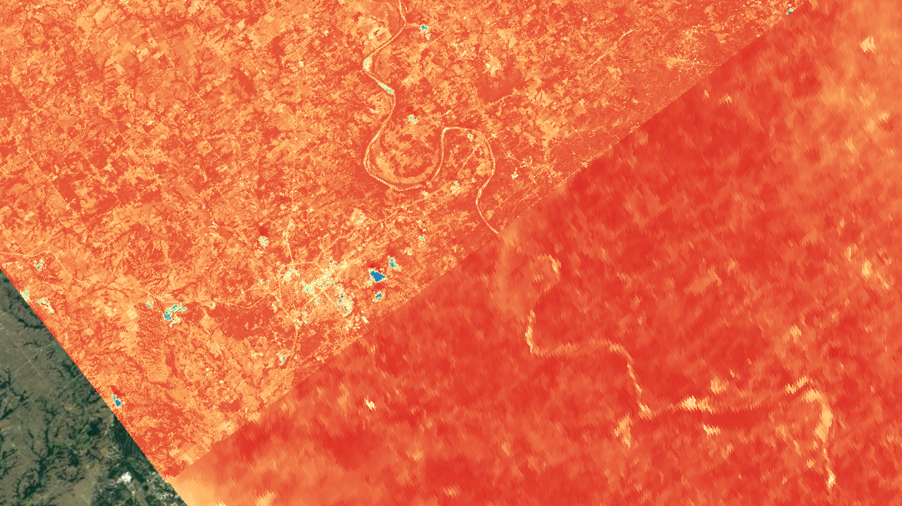
Example Output (RED band)
Fused Output
Original MODIS

Slide 13
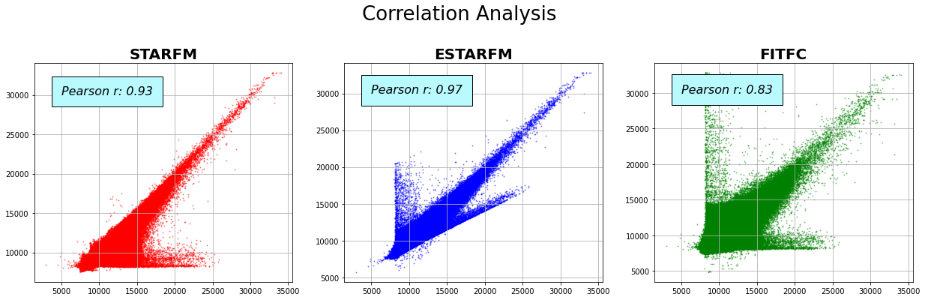
Performance Evaluation

Slide 14
Performance Evaluation
Data Warping using GDAL: ~24.5 min
Data Clipping using GDAL: 2.5 – 3.0 s per input
Data Fusion using R (Total Runtime):
FITFC: 86min
ESTARFM: 96min
STARFM: 87min
Intermediate Output File Size:
Clipped file: ~110 MB each
Resampled file: ~5.2 GB each
Final Output File Size: ~80 MB

Slide 15
Key Messages
Pre-processing time using GDAL is significant (mostly from resampling) and need to be considered part from Data Fusion processing time
Total runtime need to be considered per Landsat coverage, not per MODIS coverage
The area for successful fusion results are limited by cloud cover of BOTH Landsat and MODIS imageries
ESTARFM provides optimal results despite longer pre-processing time
Further efforts needed to improve workflow automation and inspection of fusion results recommended before further applications
The distortions data range during data fusion needed to be considered as it will impact calculation of statistical indices

Slide 16
Conclusion
Significant computational cost required for the full workflow regardless of data fusion algorithms (STARFM, FITFC, ESTARFM)
FITFC has the shortest runtime which might partially owing to the single image pair
The higher computational cost are mainly caused by data warping, merging and the small processing unit (of a Landsat coverage) compared to actual runtime time for data fusion
Precautious measures are recommended for further application of fused data in the existing workflow due to the data range distortion
Further effort required for the evaluating particular use case of Global Water Pack using fused data

Slide 17
References
F. Gao, J. Masek, M. Schwaller, and F. Hall, “On the blending of the Landsat and MODIS surface reflectance: Predicting daily Landsat surface reflectance,” IEEE Trans. Geosci. Remote Sens., vol. 44, no. 8, pp. 2207–2218, Aug. 2006.
Gevaert, C. M., & García-Haro, F. J. (2015). A comparison of STARFM and an unmixing-based algorithm for Landsat and MODIS data fusion. Remote sensing of Environment, 156, 34-44.
Jiang, J., Zhang, Q., Yao, X., Tian, Y., Zhu, Y., Cao, W., & Cheng, T. (2020). HISTIF: A New Spatiotemporal Image Fusion Method for High-Resolution Monitoring of Crops at the Subfield Level. IEEE Journal of Selected Topics in Applied Earth Observations and Remote Sensing, 13, 4607-4626.
P. Wang, F. Gao, and J. G. Masek, “Operational data fusion framework for building frequent landsat-like imagery,” IEEE Trans. Geosci. Remote Sens., vol. 52, no. 11, pp. 7353–7365, Nov. 2014.
Wang, Q., & Atkinson, P. M. (2018). Spatio-temporal fusion for daily Sentinel-2 images. Remote Sensing of Environment, 204, 31-42.
X. Zhu, J. Chen, F. Gao, X. Chen, and J. G. Masek, “An enhanced spatial and temporal adaptive reflectance fusion model for complex heterogeneous regions,” Remote Sens. Environ., vol. 114, no. 11, pp. 2610–2623, 2010.
Zurita-Milla, R., Clevers, J. G. P. W., & Schaepman, M. E. (2008). Unmixing-based Landsat TM and MERIS FR data fusion. IEEE Geoscience and Remote Sensing Letters, 5(3), 453–457, http://dx.doi.org/10.1109/LGRS.2008.919685.

